Slide 1
Welcome to the Year 11 Support Evening.
26th September
Notes:
Welcome by Jen

Slide 2
Revision, exams and intervention.
Mrs Healey
Senior Vice Principal.

Slide 3
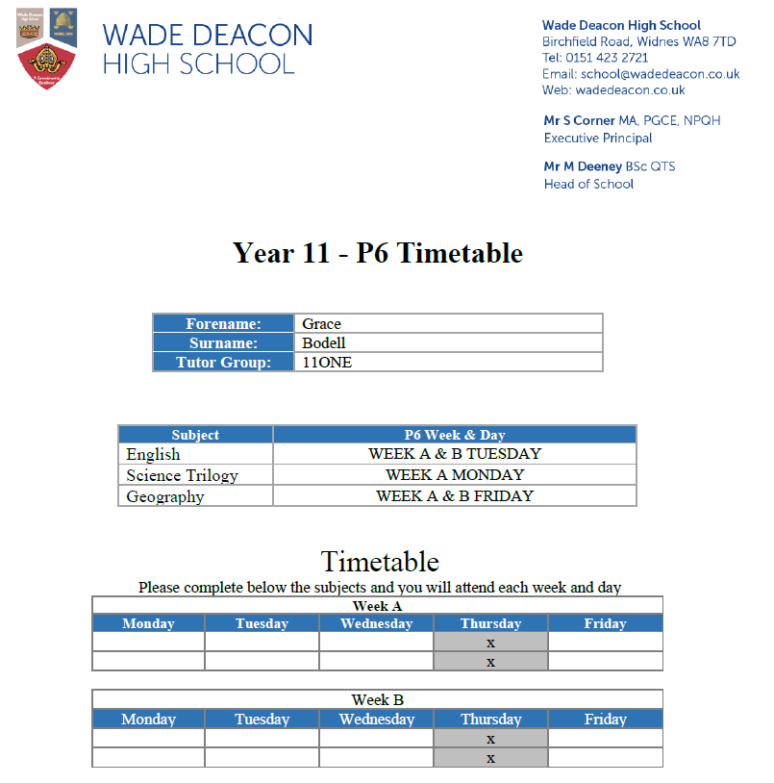
What's happening in school?
P6 Sessions
  Week A: Monday-Science, Tuesday-English, Wednesday-Maths and Friday-Options
  Week B: Monday-Science, Tuesday-English, Wednesday-Maths and Friday-Options
Saturday morning sessions, starting on 28th September
P2S1 Assessments opens 16th October-23rd October
Mock Exams Online Teams meeting 16th October
Year 11 Parents Evening on 21st November
Assemblies from colleges to support with destinations
1-1 Careers advice and guidance meetings
Careers Fair Tuesday 15th October

Slide 4
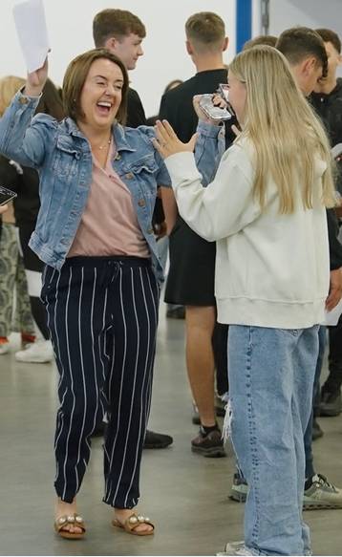
GCSE Examinations
Mock exams starting Monday 21st November- 13th December
Timetables
Access arrangements
  Reader
  25% extra time
  Prompter
GCSE Exam hub on the school website
Mock Exams Online Teams meeting 16th October
JCQ Guidelines

Slide 5
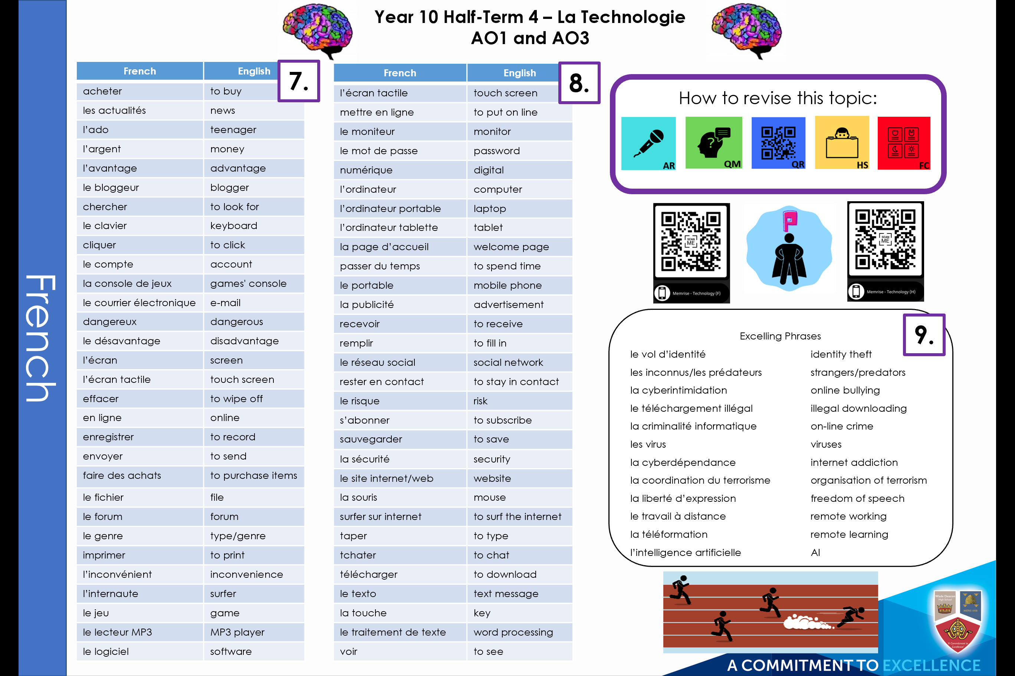
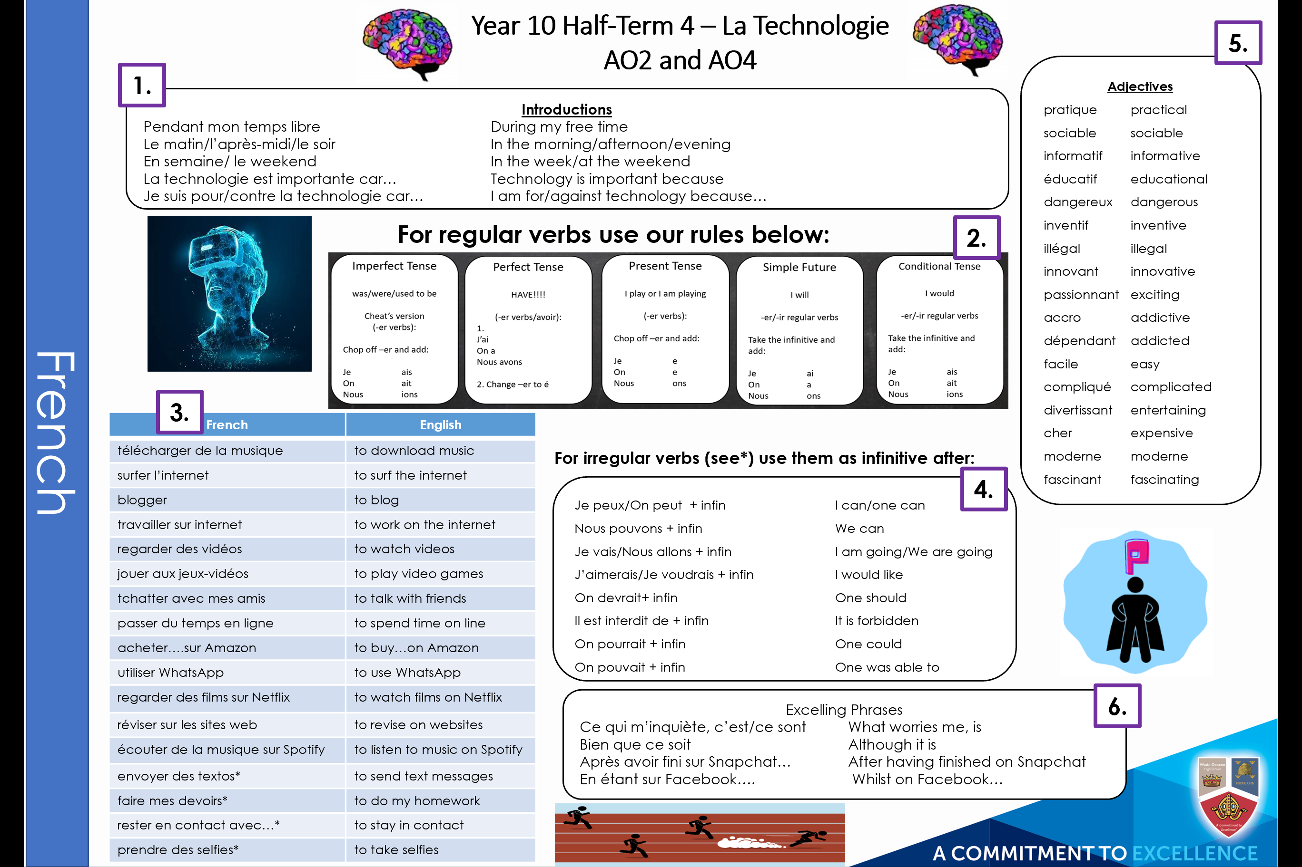

Knowledge Organisers
What do they look like?
Each Knowledge Organiser will help you to embed the Core Knowledge into your long-term memory.
Teachers have highlighted the best ways to revise and how you can demonstrate your learning.
Everything is numbered so you know what to revise and focus on during a lesson.
Links and QR codes have been included to help you find useful websites for revision.
Challenge activities are given to push your learning further.

Slide 6
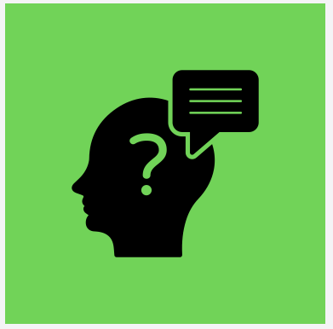
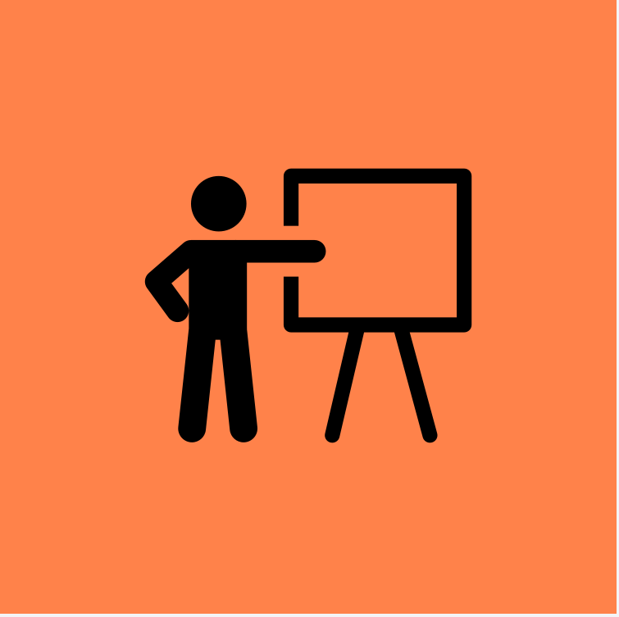
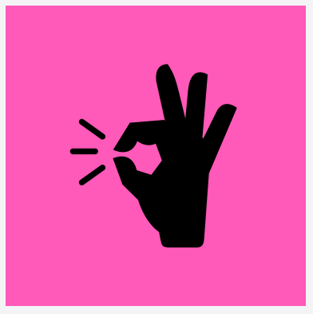
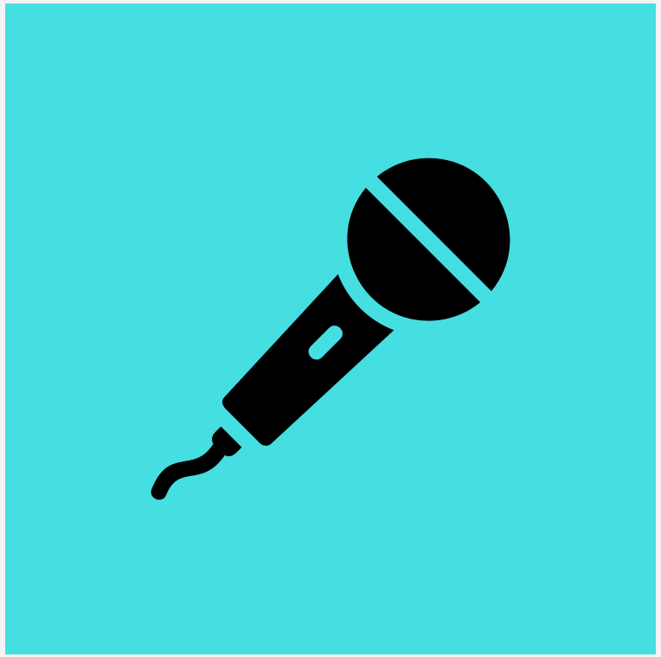
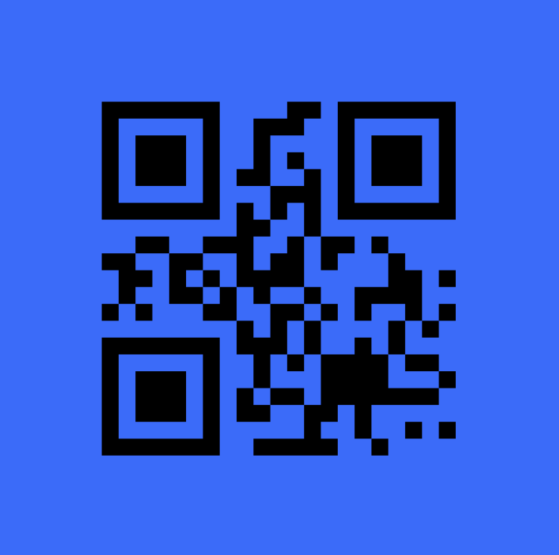
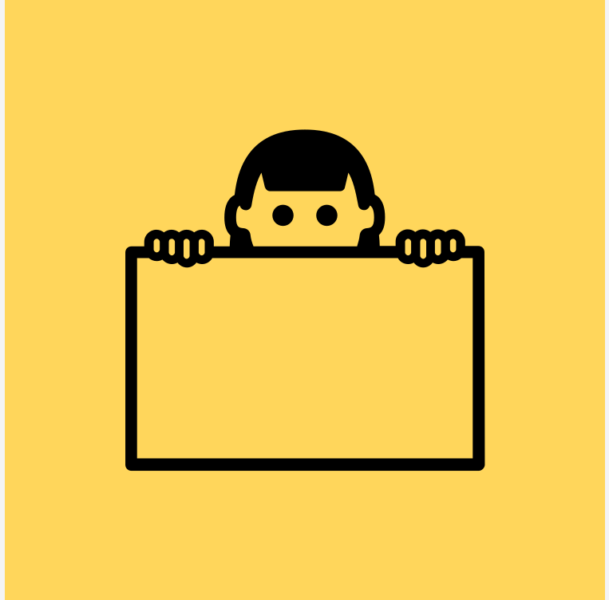
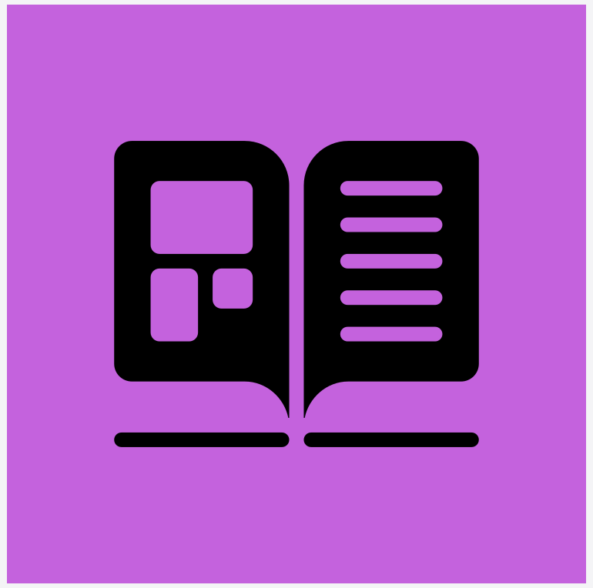
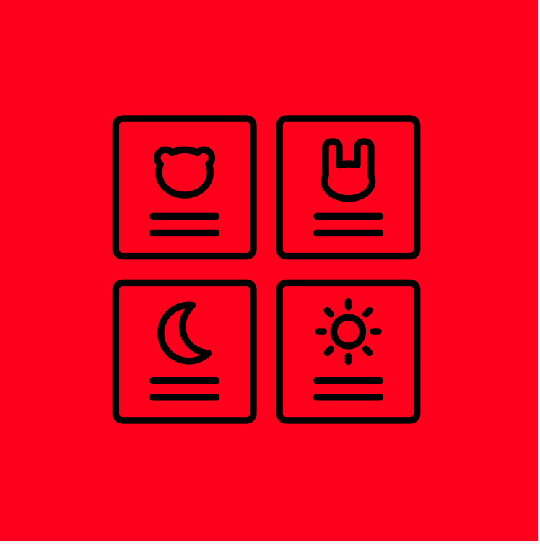
Your Knowledge Organiser
What are the different strategies to revise the Core Knowledge?
Quiz Master
Write questions and answers for the core knowledge you are revising. Test yourself and others for points.
Demonstrate it!
Take the skill from the Knowledge Organiser sheet and show me that you can do it!
Practice makes perfect!
Write the Core Knowledge over and over again until its perfect from memory.
QM
D
PP
Audio Recordings
Recordings on voice note help you to assess your progress and demonstrate what you now know.
QR Codes
QR codes with links to website where you can test your Core Knowledge i.e. Memorise/Sparks.
Hide and Seek
Revise a section of Core knowledge from the KO. Get a blank copy and see what you can fill in from memory.
AR
QR
HS
Dual Code
Take the Core Knowledge and create images to represent the information. Use the images to test your knowledge.
Flash Cards
Write key facts on the flash cards. Test your memory by getting someone to ask you questions on it.
DC
FC

Slide 7
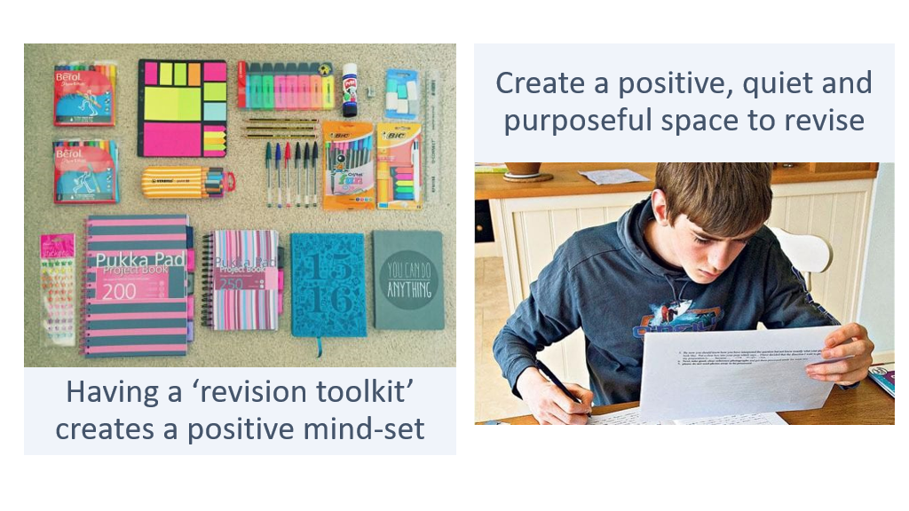

Slide 8
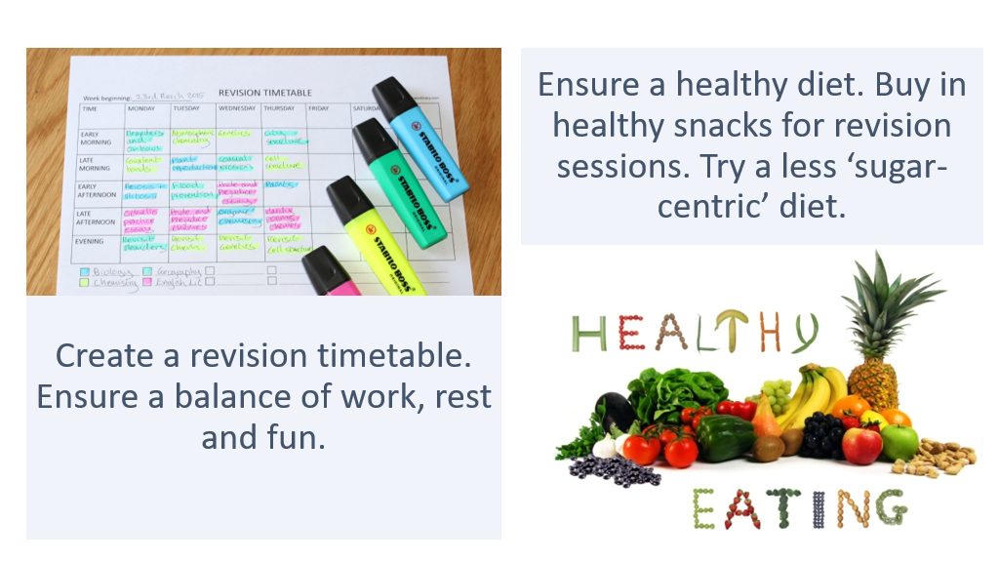

Slide 9
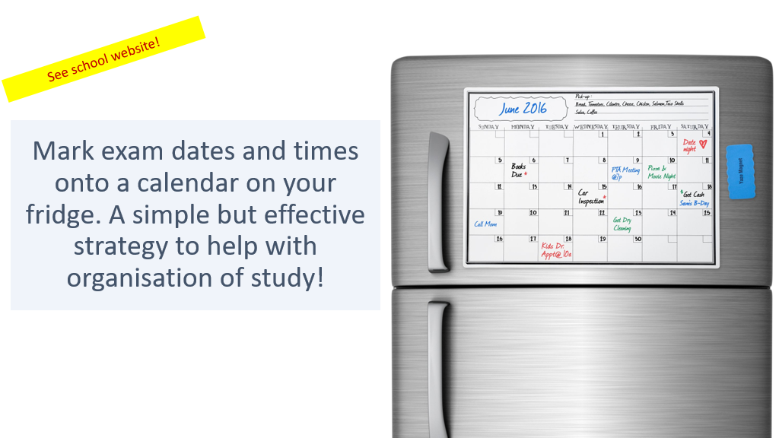

Slide 10
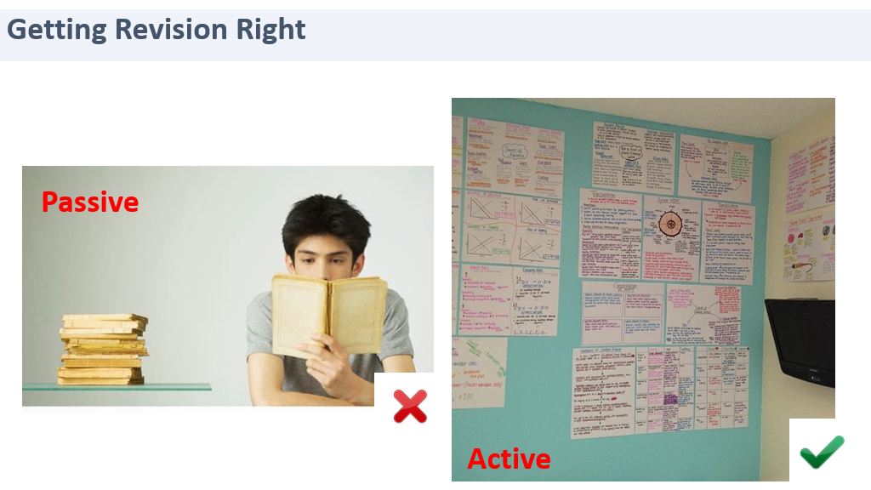

Slide 11
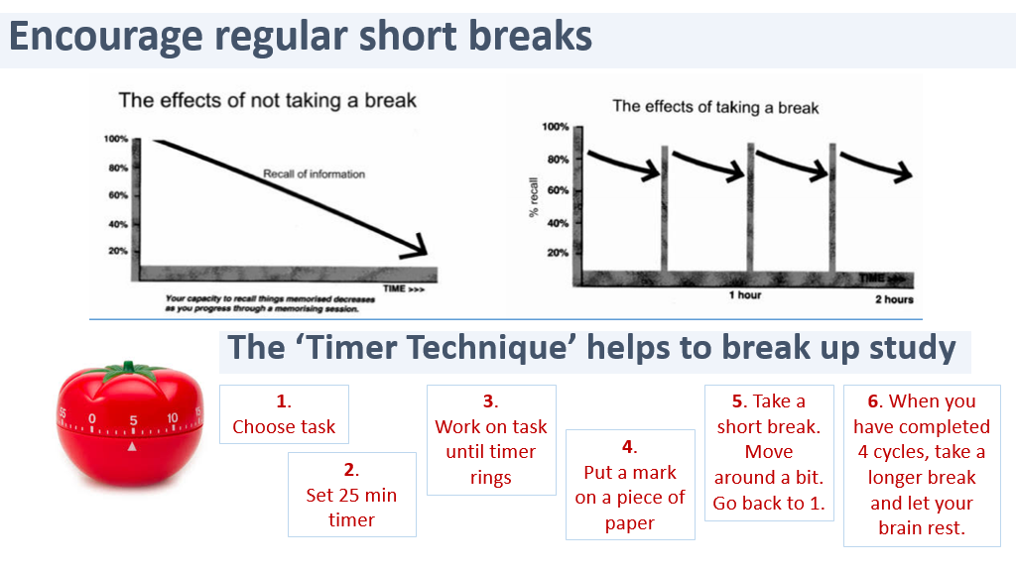

Slide 12
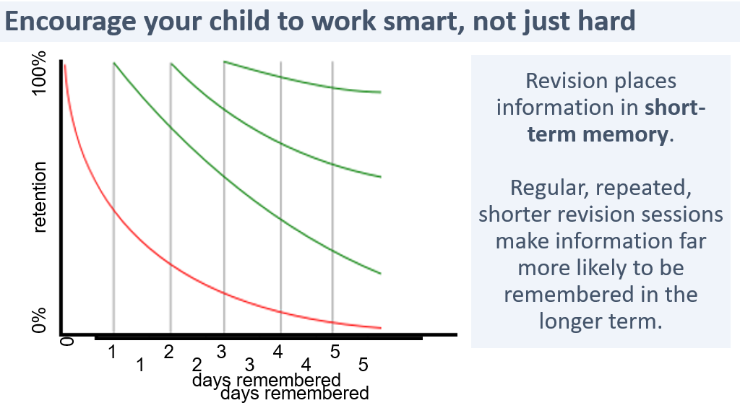

Slide 13
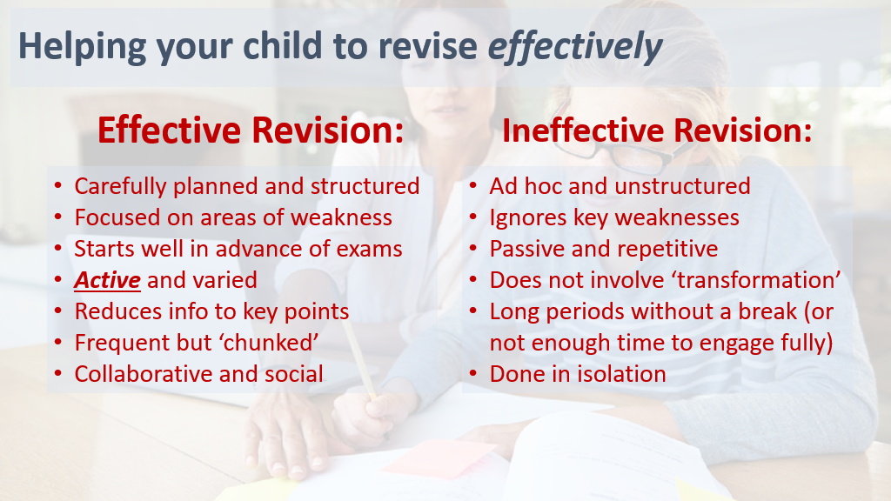
Notes:
Hand over to Rachel

Slide 14
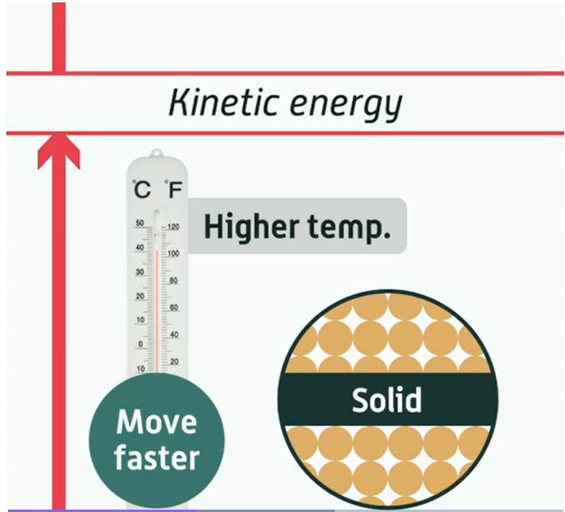
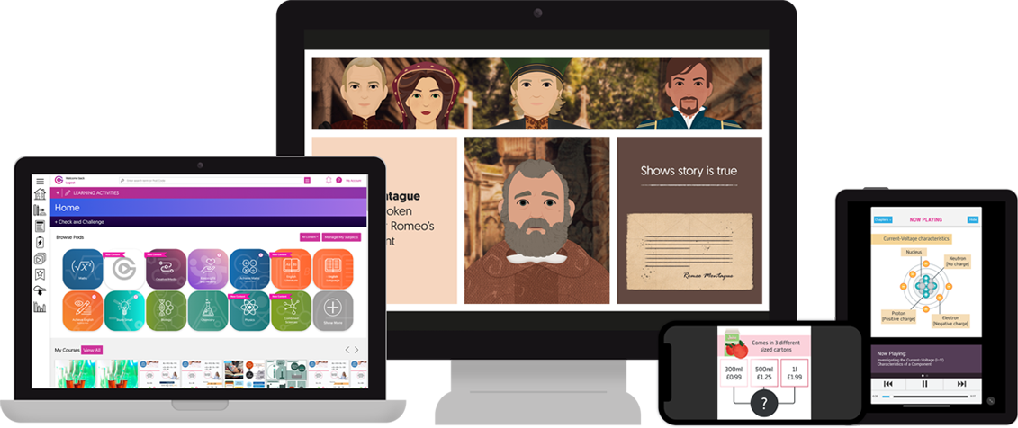
GCSEpod
3-5
minute
‘Pods’
28+
subjects
Easy
to use
Pods are 3-5 minute videos designed to keep your child engaged. They have audio and visual content that is mapped their exam board.
Notes:
Leanne

Slide 15


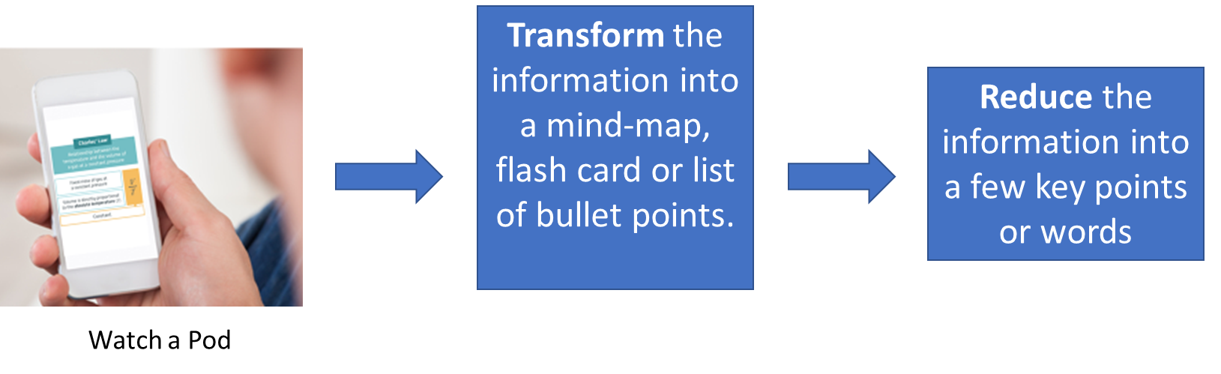
Teacher Introduction
Active and effective revision
Allows your child to test their knowledge after watching a Pod
Provides scaffolded support like a teacher would
1-2-1
Helps identify misconception in knowledge and prepare for exams
Get hints, win diamonds and watch their progress improve
Notes:
Leanne

Slide 16
Year 11 English
Ms Russell, Leader of English

Slide 17

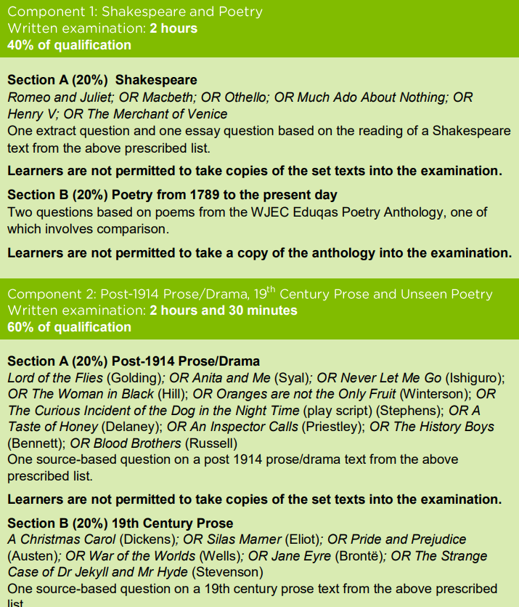
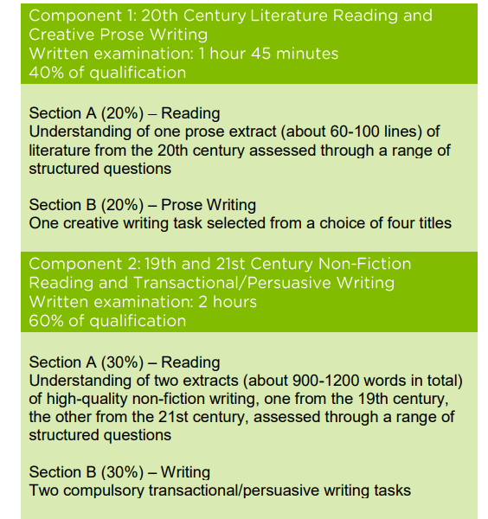
GCSE Examinations - Eduqas
English Literature
English Language

Slide 18
Mock Examinations
P2S1 – Currently sitting
  English Language Component 2 (Writing)
  English Literature Component 2 – Part (C Unseen Poetry)
P2S2 – December Mocks
  Component 1 and Component 2 English Language
  Component 2 Literature
P2S3 –March Mocks
  Component 1 and Component 2 English Language
  Component 1 English Literature

Slide 19

Key Dates
English Literature Component 1 (Macbeth and Anthology Poetry) Tuesday 13th May
English Literature Component 2 (A Christmas Carol, An Inspector Calls and Unseen Poetry) Tuesday 20th May
English Language Component 1 – Fiction Friday 23rd May
English Language Component 2 – Non-Fiction Friday 6th June

Slide 20




Online Resources

Slide 21
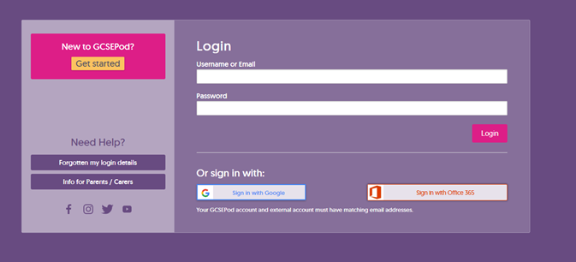
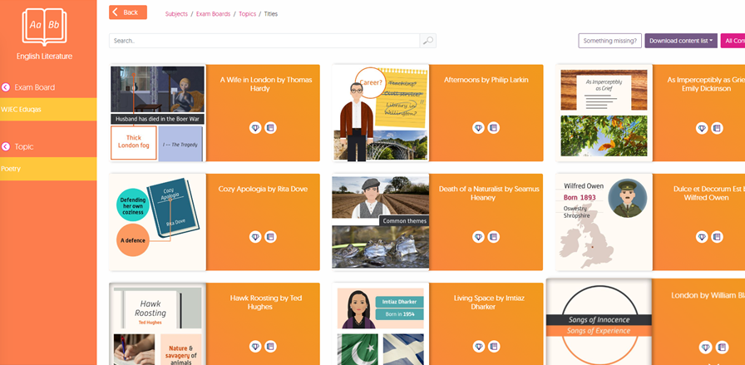
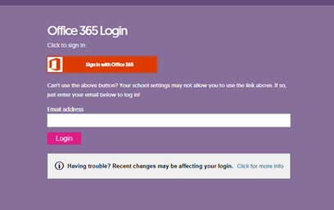
Online Resources

Slide 22

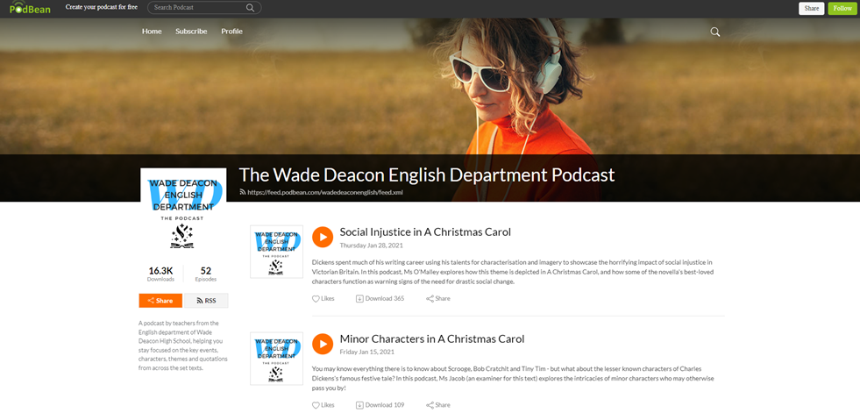
Online Resources

Slide 23
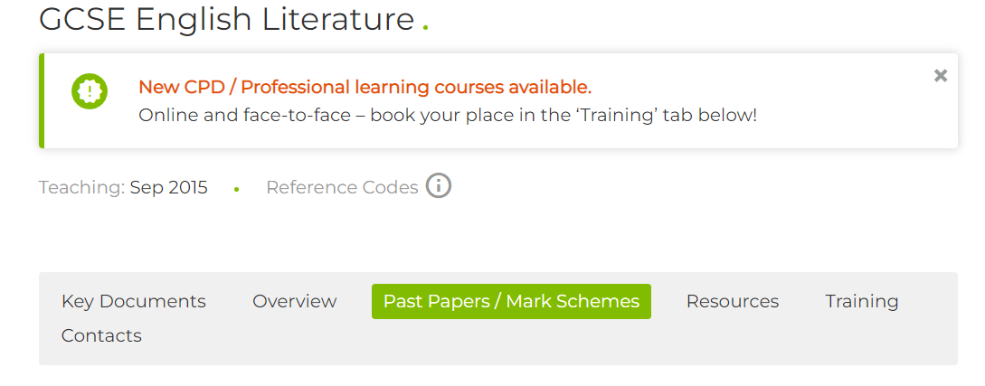
Past Papers
www.eduqas.co.uk/qualifications

Slide 24





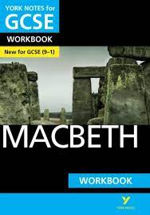

Revision Guides
Revision Guides
Revision Guides
Find notes on the plot, characters, themes, context, imagery, and use of language.
Annotated sample answers and extracts.
Top Tip and Aiming High features to maximise your potential.
Revision activities and checkpoints.
Workbooks
Test yourself: quick tests and longer questions.
Write-in tasks and exercises to enhance your knowledge of the text.
Plot and Action and Characters to Key Contexts and Themes, Language and Structure.
Sample paragraphs and exam-style questions.
Monitor your progress at every stage using the Progress log.

Slide 25



Personal copies of the texts

Slide 26

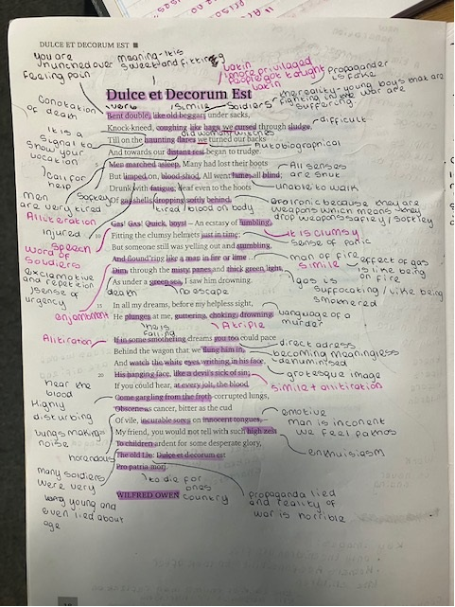
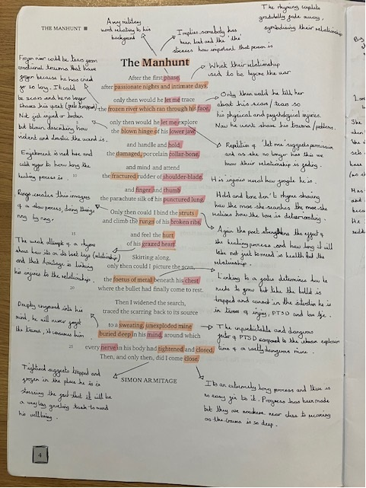
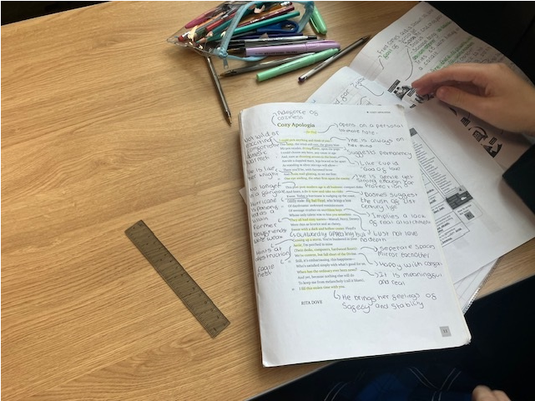
Poetry Anthologies

Slide 27
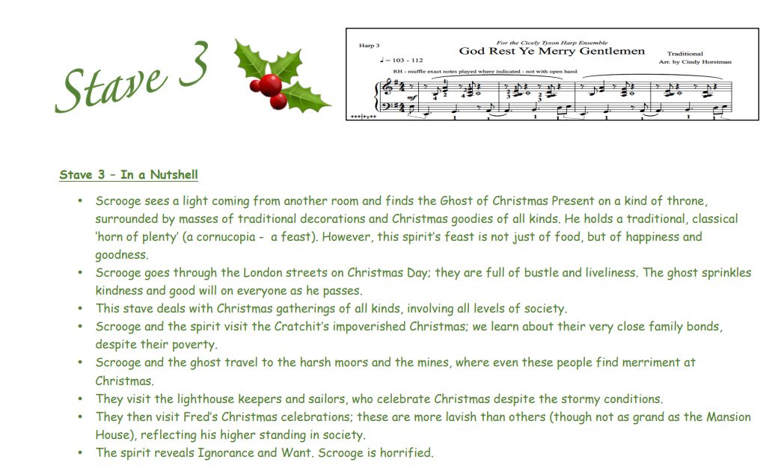
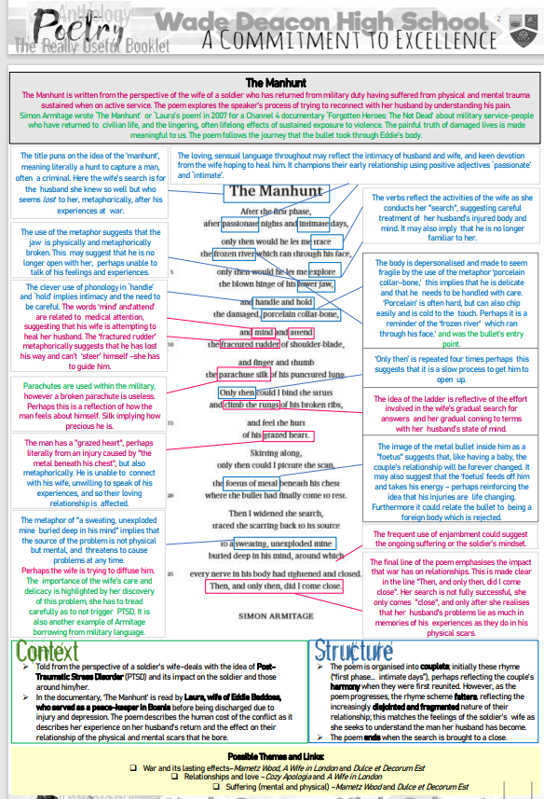
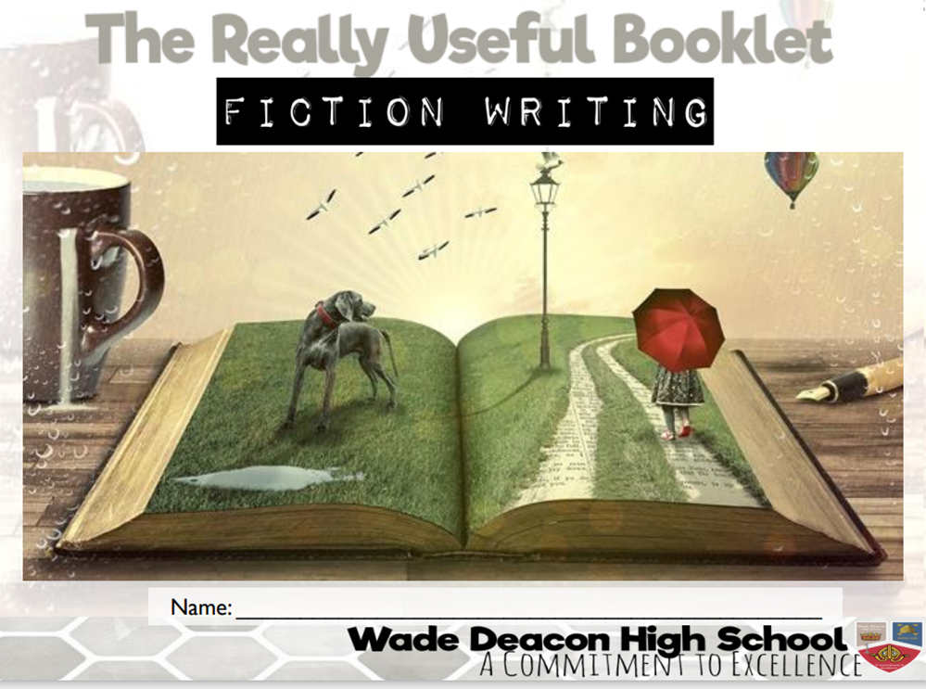
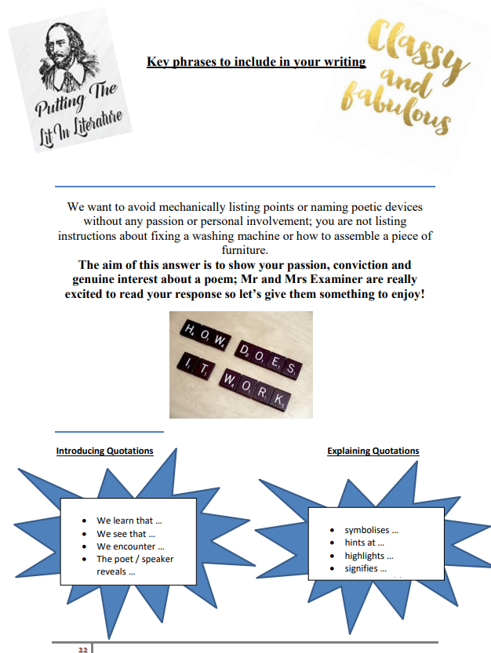
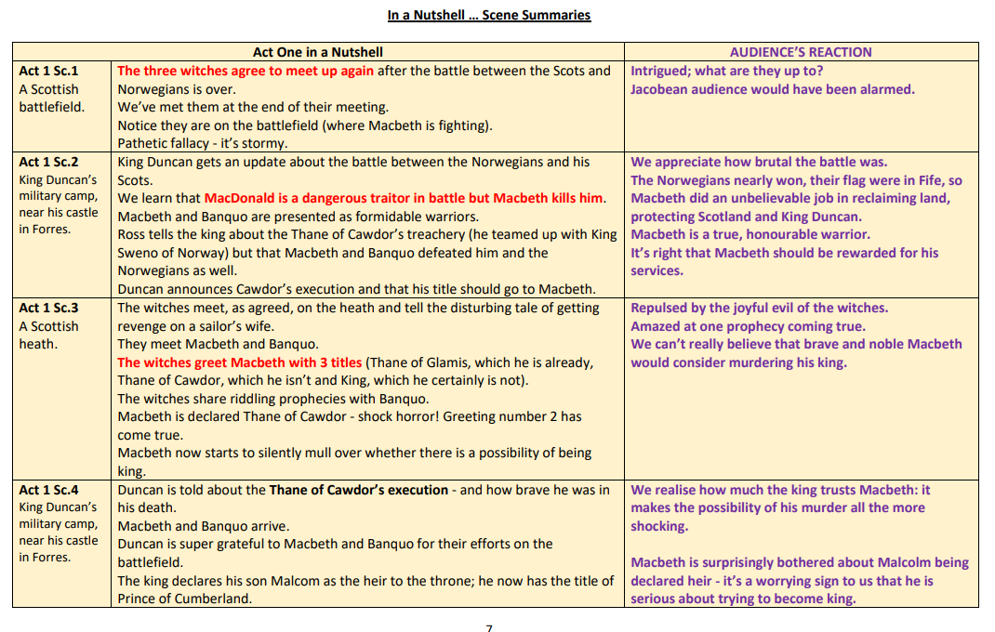
The Wade Deacon Way!
The Really Useful Booklets

Slide 28
Year 11 Mathematics
Ms Lewis, Leader of Maths

Slide 29
Year 11 Mathematics
GCSE Examinations
Mock Examinations
QLA (Question Level Analysis)
Sparx Maths
Past Papers
Useful Websites

Slide 30
GCSE Examinations
Board: Edexcel
Higher Tier – Grades 9 to 4
Foundation Tier – Grades 5 to 1
Three Papers
  1h30m each paper
  Paper 1 – Non Calculator
  Paper 2&3 – Calculator
Provisional Dates
  Thursday 15th May – Paper 1 (Non Calculator)
  Wednesday 4rd June – Paper 2 (Calculator)
  Wednesday 11th June – Paper 3 (Calculator)

Slide 31
Mock Examinations
P2S1 – Next two weeks
  In Class
  All three papers
P2S2 – December Mocks
  All three papers
P2S3 –March Mocks
  All three papers

Slide 32
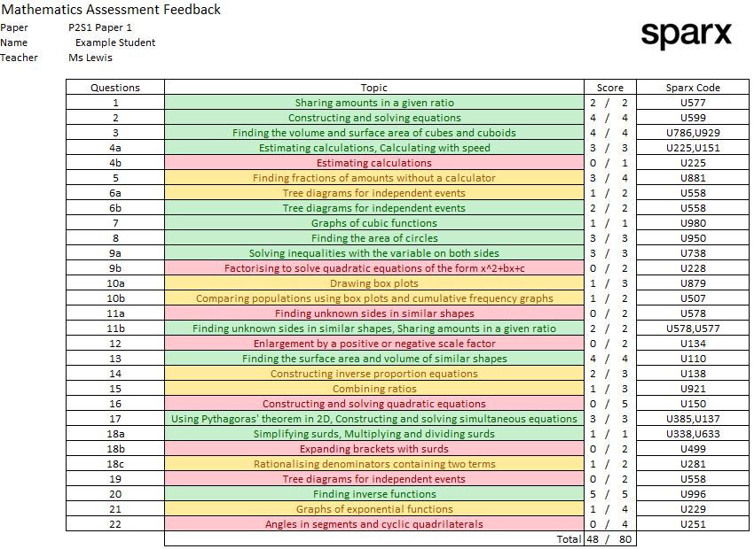
QLA (Question Level Analysis)

Slide 33
Sparx Maths
Compulsory Homework – Students must have 100% complete and correct
XP Boost & Target – Optional
Independent Learning – Use the QLA for personalised topics

Slide 34
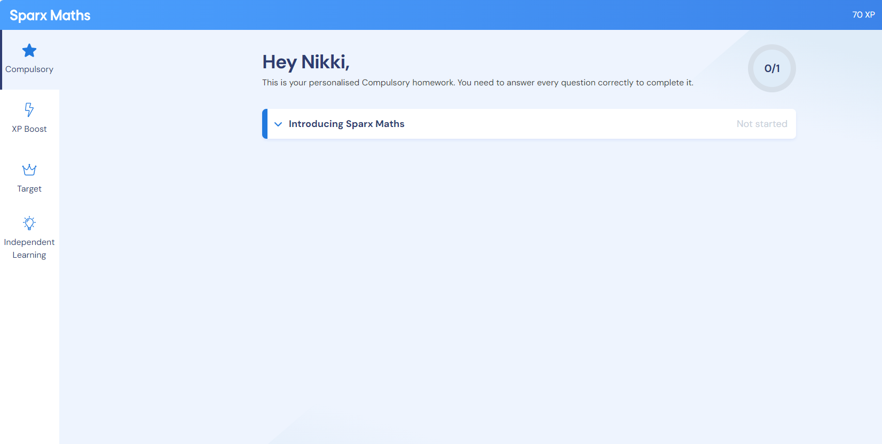
Sparx Maths

Slide 35
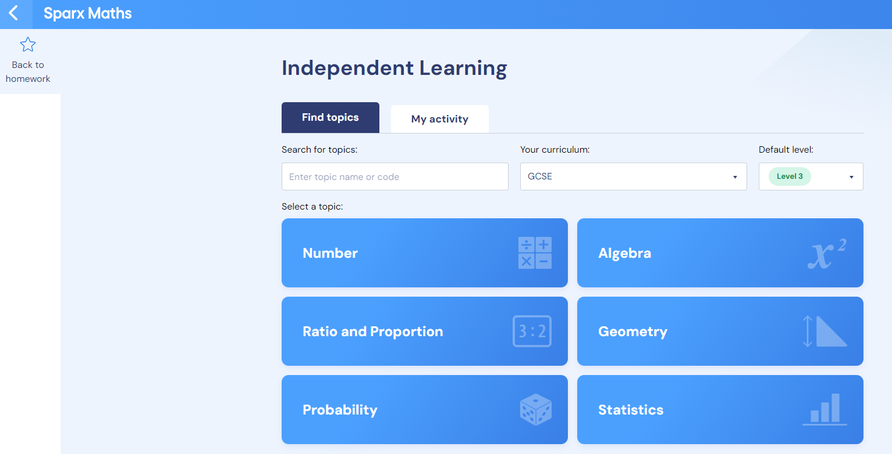
Sparx Maths

Slide 36
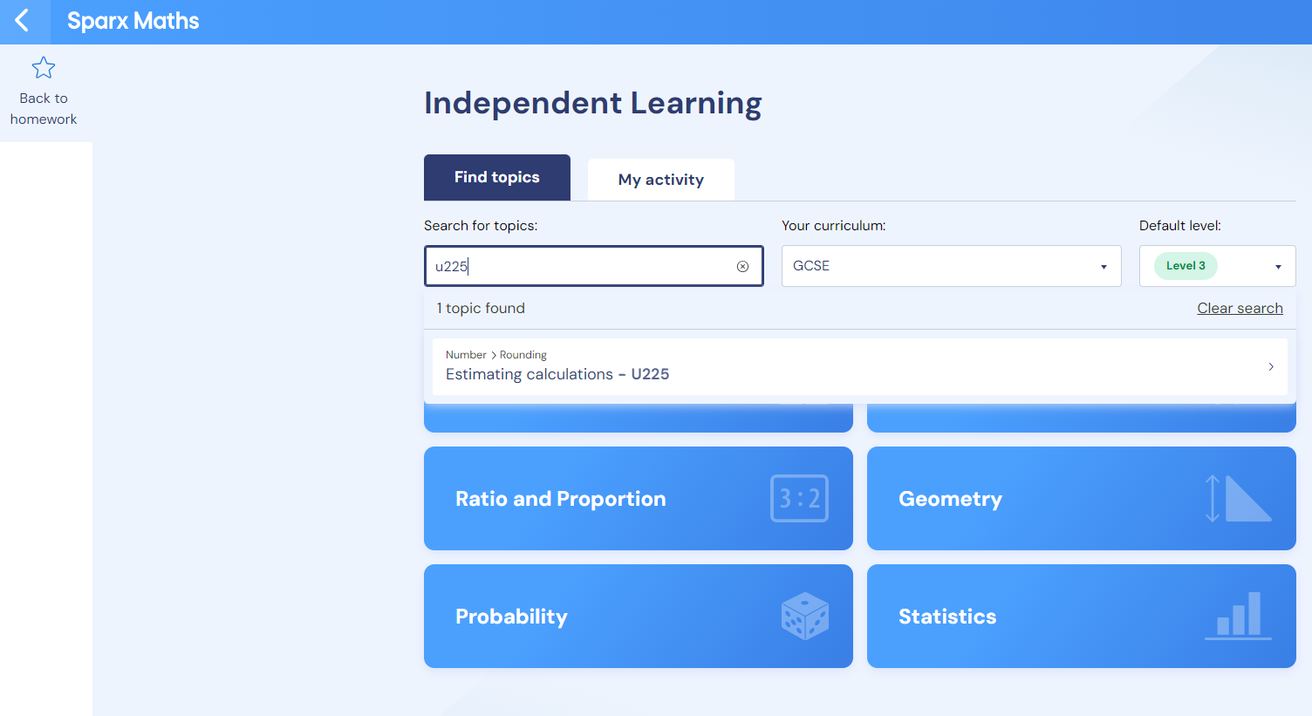
Sparx Maths

Slide 37
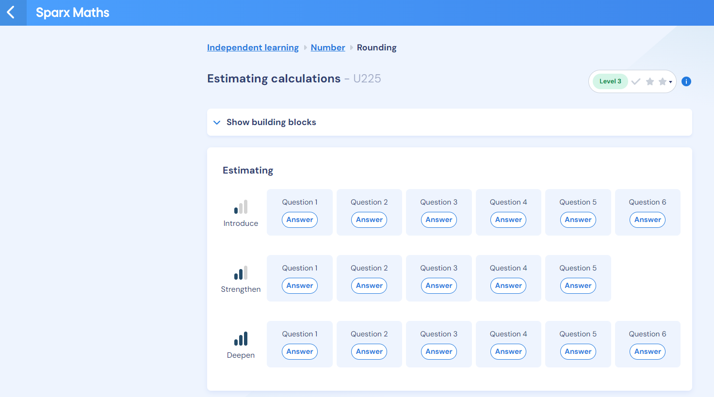
Sparx Maths

Slide 38
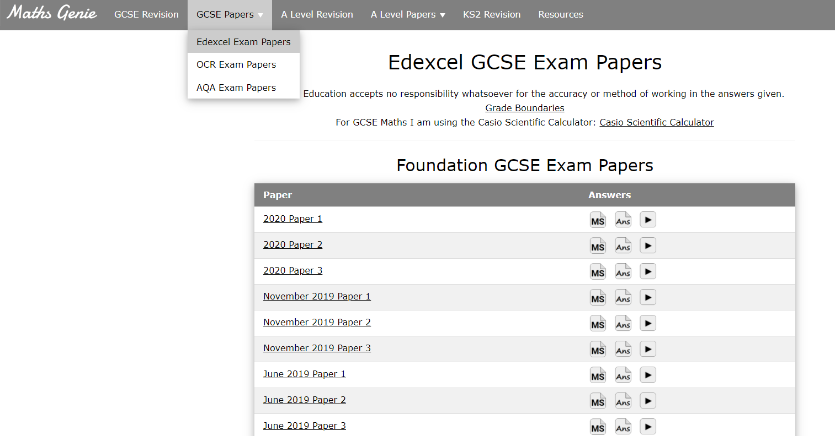
Past Papers
www.mathsgenie.co.uk

Slide 39
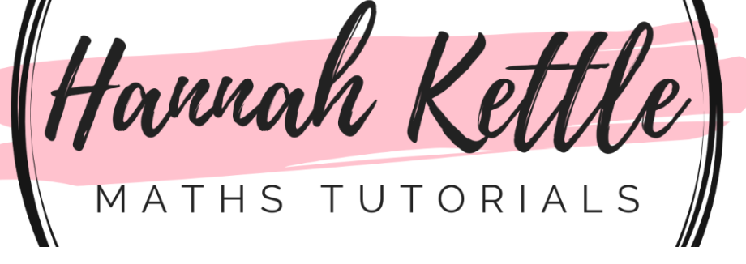
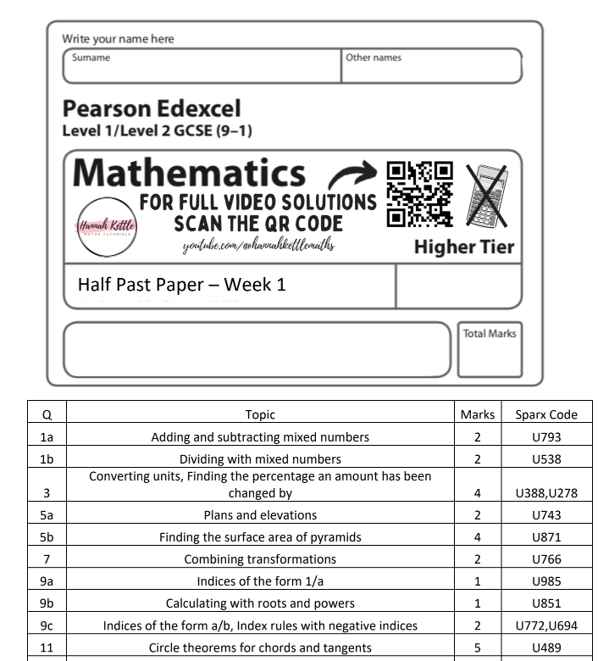
www.hannahkettlemaths.co.uk

Slide 40
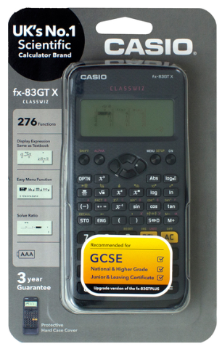
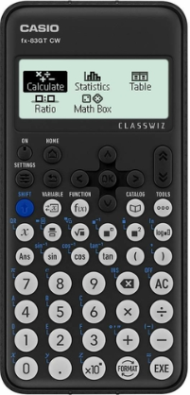
Useful Websites
Past Papers
www.mathsgenie.co.uk
Half Papers
www.hannahkettlemaths.co.uk
Topic Questions
www.corbettmaths.com/content
Historical Grade Boundaries
www.mathsbot.com/gcse/boundaries
Notes:
Hand over to Steph

Slide 41
Science
Mr Seiffert, Leader of Science

Slide 42
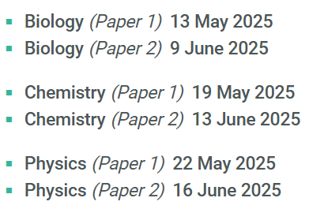

Separate Sciences- 1 hr 45 minutes
Assessment
Combined Trilogy- 1 hr 15 minutes
P2S1&P2S2 – Paper 1 Content
P2S3 – Paper 2 Content
6 papers
2 x biology, 2 x chemistry and 2 x physics.
Each of the papers will assess knowledge and understanding from distinct topic areas.
Provisional GCSE Dates
6 papers
2 x biology, 2 x chemistry and 2 x physics.
The same as trilogy but with some additional content.

Slide 43

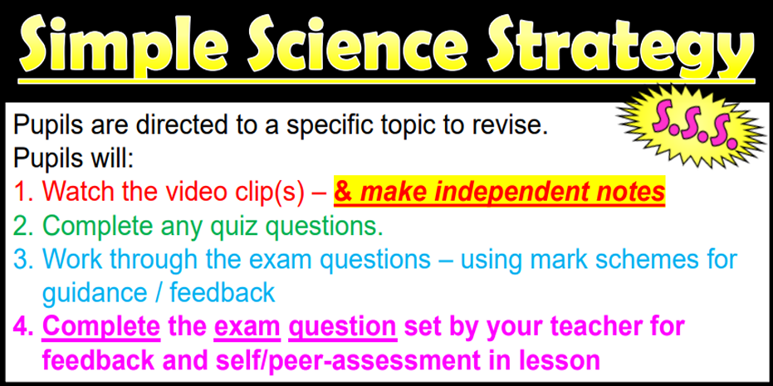





Wade Deacon Science Revision Strategy
Coming October 2024

Slide 44

Resource Links
Free
Sparx Science www.sparxscience.com
  Online Resource with access to textbooks, exam questions and retrieval tasks
Kerboodle www.kerboodle.com
  Online Resource with access to textbooks, exam questions and retrieval tasks
Focus E-Learning www.focuseducational.com
  Interactive resource to allow students to conduct practical work at home
Cognito (Free/£50 for Pro Version) www.cognitoedu.org
  Revision platform that includes tutorial videos, quiz questions and exam practice.
MygcseScience (£25/£50 per license) www.my-gcsescience.com
  Revision platform that includes tutorial videos, quiz questions and exam practice.
Free
Free

Slide 45



Free Online Platforms

Slide 46


Other online platforms

Slide 47

Focus Learning

Slide 48


Exam Papers
AQA | Find past papers and mark schemes

Slide 49
Wade Deacon Science Revision Strategy

Slide 50
Care, Guidance and Support
Mrs Harrison
Designated Safeguarding Lead and Senior Link for Year 11

Slide 51
Attendance Matters
The data below is based on the performance of last years leavers.
Attendance | Average Attainment Grade
100% | 6.16
97-99% | 5.5
95-96% | 5.25
92-94% | 4.45
90-91% | 4.06
80-89% | 3.41
70-79% | 2.89
Notes:
If you have attendance of 100% your average grade across all your subjects that you study at GCSE is most likely to be slightly above a grade 6 based on our previous students performance last year.
If your attendance is just 3% lower than this, at 97%, which you may see as positive, you reduce your chances of getting an average grade over a 6 by over half a grade to 5.5 in every subject you study. This means by 3% lower attendance you reduce your average grade by half a grade in every subject you study.
If your attendance is 95%, again some may feel that is high, but our data would suggest that your average grade across all your subjects would be just over a grade 5. However, given what we know about changing grade boundaries and uncertainty about exam performance on the day, this could be the difference between securing that grade 5, or not, which could impact on your post 16 pathways.
This data shows that if you can improve your attendance by just 1% to 95%, you could improve your average grade across every subject from a grade 4 to a grade 5.
If your attendance is below 91%, your average grade is below a 4 in every subject which could seriously hinder your success in securing the college placements, apprenticeships and jobs you may be seeking for when you leave school.
This pattern is the same across English, Maths, Science, Humanities and other subject areas in that statistically when your attendance is lower, your average grade in all your subjects is also lower. You must remember when you are applying to college or seeking employment and apprenticeships, that you are competing against hundreds of other people, therefore you must ensure you are not only on a level playing field, but ahead of everyone else, by ensuring you maxmise your grades by high levels of attendance.

Slide 52



Support available during Year 11
Progress Leader: Miss Barker
Assistant Progress Leader: Mr Maybury
SLT Link: Mrs Harrison
SLT Progress and exam support: Mrs Healey and Mrs Gallagher
Mentor support for well-being: Mrs Black
SENDCO support: Mrs Webster
Career guidance support: Jane Conlon
College applications information: Miss Griffiths
Form tutor, every morning you can speak to your form tutor
Parents/Carers
The best support you can get is from your class teacher for each subject, you can always send your teacher a Synergy Message
Subject leaders, if your class teacher isn’t available speak to the subject leader
Peer support from your friends
Exam Hub on the Website
School Counsellor
Mental Health Support Team
Notes:
Mike to overview

Slide 53

Exam Stress Workshop
Mental Health Support Team
Rebecca Ratcliffe I Senior Mental Health Practitioner
Tracey Connolly | Education Mental Health Practitioner

Slide 54






Who are we?
:
Halton Mental Health Support Team (MHST) is an NHS service providing mental health support to primary schools and secondary schools in Halton.
We aim to help young people to learn strategies and new ways of taking care for their mental wellbeing.
We provide interventions to pupils struggling with anxiety, low mood or behavioural difficulties.
..and deliver talks like these!

Slide 55







Stress is normal
especially when taking assessments, mocks and exams!
Stress can make young people feel:
Notes:
Tired
Low in mood
Like your mind is blank
Feeling unwell or getting headaches
Worried or nervous
Unmotivated
There is a change in your appetite
Like it is having an impact on your relationships
Like a failure

Slide 56

The Stress Performance Curve

Slide 57


Anxiety as a continuum
No anxiety:
“I’m OK!”
Mild anxiety:
everyday stress, upset or worry.
High anxiety: anxious thoughts and physical symptoms.
“I’m not OK!”
0 1 2 3 4 5
6 7 8 9 10
Anxiety is caused by our perception of threat.
We overestimate the threat.
We underestimate our ability to cope.

Slide 58
It’s all about balance
Assessments
Mocks
Exams
Relaxation and sleep
Family and friends
Food and Hydration
Leisure and Socialising

Slide 59
It’s all about balance
Family and friends (limited)
Assessments
Mocks
Exams
Food and Hydration
Relaxation and sleep
Leisure and Socialising

Slide 60
It’s all about communication
Step 1: Empathy
“Connect before correct”
Recognise all emotions as being natural, normal and not a matter of choice. Take on the child’s perspective.
Step 2: Validate and label their feelings
Be present, take notice and really listen. “You appear to be feeling angry. It’s understandable given how much pressure you’re under. Pressure makes me angry too sometimes.”
Step 3: Set limits
“You’re angry that I’ve taken your phone. We agreed to do this when you’re trying to revise so that you can focus. Shouting at me is not ok. I will keep your phone safe and you can have it back in one hour.”
Step 3: Problem solving
“Next time you’re feeling like this what can you do? What are your options? Which option is the best? What do you need to do to give this a try?”

Slide 61
How can we practice self-care before exams?
Minor revision
Prepare equipment
Relaxation
Positive thoughts
Stay hydrated
Eat breakfast
Set alarms
Get some sleep
Notes:
I'm sure you have all heard these tips before, but as a reminder here are 8 suggestions of things you should do the night before an exam.
1. Only do minor revision, for example reading over notes. As tempting as it might be do not try to learn anything new, and we don’t tend to retain much information by cramming it in. If you're going to revise just recap what you already know and co Try not to do a lot of last minute revising as research shows that we don't retain much information in this way. Spend a short time reminding/recapping the night before and then do something that you enjoy/makes you happy and then spend time relaxing before bed time.
2. Make sure you are prepared – have all your equipment ready and packed in your bag. Don't leave it until the morning to realise you've lost your calculator
3. If possible try to relax – some people find exercise relaxing, other people have a bath or watch TV
4. Drink lots of water and eat a healthy meal
5. Some people find it difficult to eat when they're stressed but a healthy meal the night before, and for breakfast is important
6. Set an alarm, don't reply on a parent waking you up in time and make sure all your things are organised and youre not leaving it last minute to get everything you need together.
7. Some people find positive thoughts or breathing exercises helpful before they sleep, or to help them sleep if they're struggling. Remind yourselves of the positives and keep the exam in perspective.
8. It can be difficult to switch our brains off but it's important we get a nights sleep before an exam

Slide 62
How can we practice self-care after exams?
Get outside and move
Try not to compare answers
Do something fun
Positive thoughts
Give yourself credit
Eat well
Relaxation
Get some sleep
Notes:
I'm sure you have all heard these tips before, but as a reminder here are 8 suggestions of things you should do the night before an exam.
1. Only do minor revision, for example reading over notes. As tempting as it might be do not try to learn anything new, and we don’t tend to retain much information by cramming it in. If you're going to revise just recap what you already know and co Try not to do a lot of last minute revising as research shows that we don't retain much information in this way. Spend a short time reminding/recapping the night before and then do something that you enjoy/makes you happy and then spend time relaxing before bed time.
2. Make sure you are prepared – have all your equipment ready and packed in your bag. Don't leave it until the morning to realise you've lost your calculator
3. If possible try to relax – some people find exercise relaxing, other people have a bath or watch TV
4. Drink lots of water and eat a healthy meal
5. Some people find it difficult to eat when they're stressed but a healthy meal the night before, and for breakfast is important
6. Set an alarm, don't reply on a parent waking you up in time and make sure all your things are organised and youre not leaving it last minute to get everything you need together.
7. Some people find positive thoughts or breathing exercises helpful before they sleep, or to help them sleep if they're struggling. Remind yourselves of the positives and keep the exam in perspective.
8. It can be difficult to switch our brains off but it's important we get a nights sleep before an exam

Slide 63


The Stress Bucket
Not spending time with friends
Family life, arguments
Sad
Pressure from work and school
Worried
Unwell
Anxious
Tired
Poor sleep, unhealthy eating
Exams
Mock Exams
Assessments
Revision
Homework
School
Friendships
Relationships
Family Dynamics
Social Media
Appearance
Hormones
Identity
Post-16 Choices
Food and Staying Healthy
Social and Hobby Time
Talk to family and friends
Watch a film I enjoy
Go for a walk
Get a bath and an early night
Exercise
Put my phone on silent
Adolescent extras
Notes:
Stress Bucket Demonstration

Slide 64


Slide 65


Slide 66


Slide 67


Slide 68


Slide 69


Slide 70


Slide 71


Slide 72


Slide 73


Slide 74


Slide 75


Slide 76


Slide 77


Slide 78


Slide 79


Slide 80


Slide 81


